Slide 1
Tech Meeting – Design Patterns
What they are, why we need them and how to use them

Slide 2

How To Use This PowerPoint Template
This PowerPoint template uses the Slide Master (View Menu->Slide Master). All slides based on this template should use the formatting and layout from the Slide Master.
When creating new slides, use the New Slide dropdown on the Home menu, and pick your desired layout
If copying slides from another presentation into this one, there will likely be a different Slide Master. This means additional layouts will be created for the slides copied in. These layouts will likely be inconsistent with this formatting and need to be updated. Unfortunately there is no mass-update, it needs to be done for every slide that is imported. To change Layout, use the Layout dropdown on the Home menu and select one of the layouts in the “Exceedra Template 2014” category. Once the layout is selected, press the Reset button on the Home menu to update any formatting.
Style Guidelines –
  Use the Title Page Layout on your first slide
  Use the Agenda Page (next slide) as dividers between sections
  Use the Last Page Layout for your last slide, to mark the end of the presentation
  Aim for a consistent font size throughout
  Use the Arial font throughout. The previous Raleway font is not widely available.
  Use the colour scheme included on the last slide. Text should generally be in colour R 89, G 89, B 89 (dark grey), textbox background or border colours should generally be in colour R 165, G 165, B 165 (light grey)
Improvements? Confused? Feedback to Richard or Ed.

Slide 3
1
What design patterns are?
2
Why do we need them?
3
The classification of design patterns by the Gang of Four
4
Demos

Slide 4
What design patterns are?
Design patterns are very non-specific templates for common code design problems. They are abstractions that we lay on top of code, not concerned with specific implementations - they just give us a starting point to solve the problem.

Slide 5
1
What design patterns are
2
Why do we need them?
3
The classification of design patterns by the Gang of Four
4
Demos

Slide 6
Why do we need them?
they form a language for developers - each pattern has a name that corresponds with a specific design template, so it's easier to talk about them because everyone knows what you mean straightaway
we don't need to reinvent the wheel - design patterns are solutions that have already been created for us by others so it's faster to use them instead of designing everything by ourselves from the scratch
they operate on abstractions that improve our code quality because we achieve much better separation of concerns, clear class responsibilities and our code is much easier to read and maintain

Slide 7
1
What design patterns are
2
Why do we need them?
3
The classification of design patterns by the Gang of Four
4
Demos

Slide 8
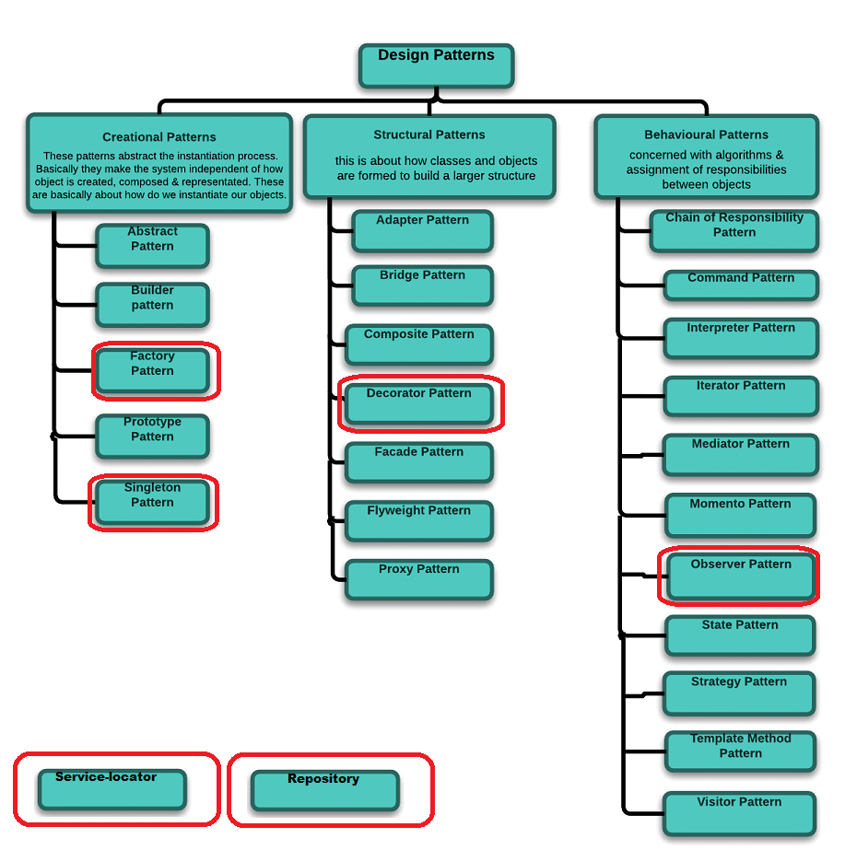
The classification of design patterns by the Gang of Four

Slide 9
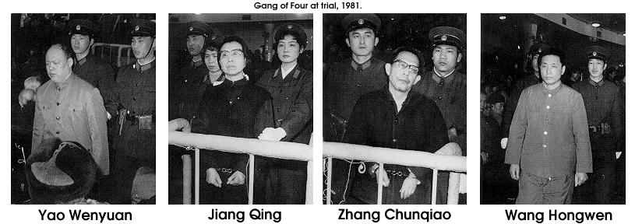
What is the Gang of Four?

Slide 10
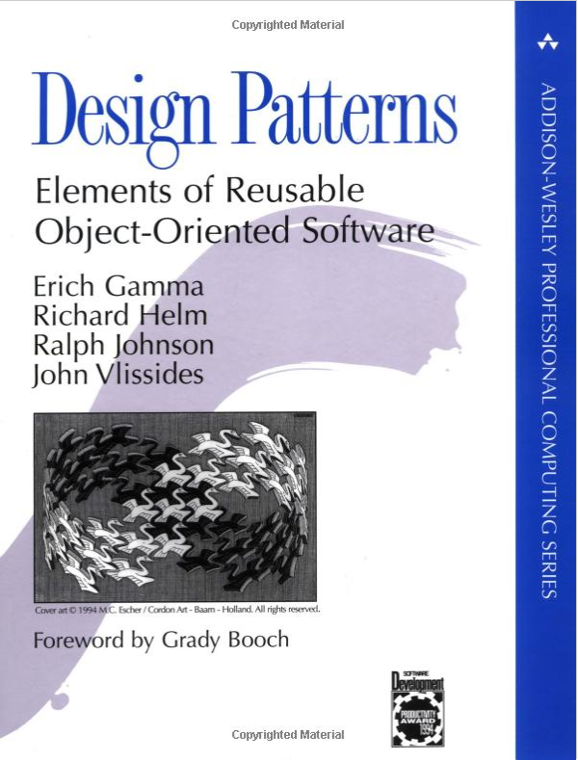
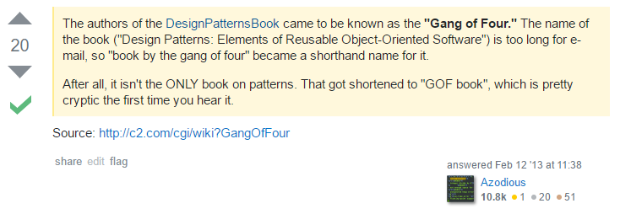
What is the Gang of Four? - revisited

Slide 11
1
What design patterns are
2
Why do we need them?
3
The classification of design patterns by the Gang of Four
4
Demos

Slide 12
1
Singleton
2
Repository
3
Service-locator
4
Observer
5
Decorator
6
Factory

Slide 13
Singleton – when?
we need to have only one instance of a class
for lazy loading (creating a class only when it's first needed - for example when creating the instance is expensive, then it can improve performance)

Slide 14
Singleton – consequences
by many considered as an anti-pattern
violates the Single Responsibility principle
the default implementation is not thread-safe
difficult to test
replaceable by the IoC (Inversion of Control) container which conforms to the SRP because it's a separate class with just this concern, is thread-safe and easy to test

Slide 15
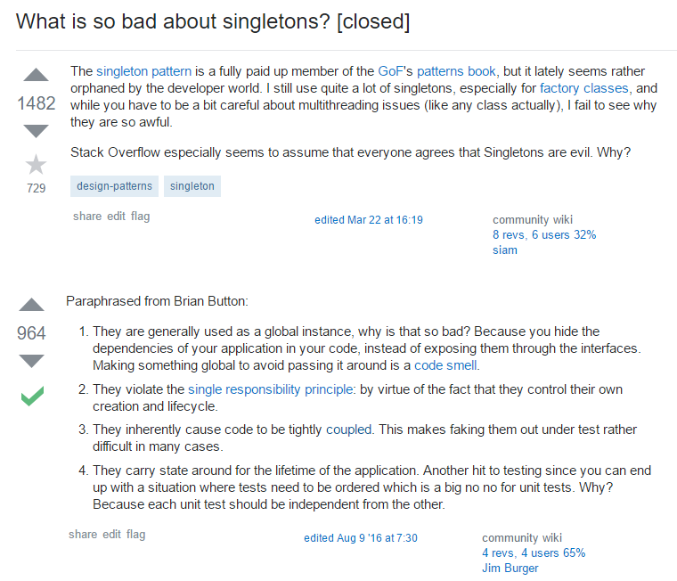
Singleton – anti pattern

Slide 16
1
Singleton
2
Repository
3
Service-locator
4
Observer
5
Decorator
6
Factory

Slide 17
Repository – when?
creating a data access layer to avoid duplicating data access implementation details (i.e. opening a sql connection)

Slide 18
Repository – consequences
higher level of code abstraction - makes it more maintainable and testable, though we end up having more classes
in some cases data queries may also be harder to optimise, however they are various ways to walk around it

Slide 19
1
Singleton
2
Repository
3
Service-locator
4
Observer
5
Decorator
6
Factory

Slide 20
Service-locator – when?
we have functionality used throughout the application (a service) that is independent from the business logic (i.e. logging)

Slide 21
Service-locator – consequences
following the SOLID principle: Single Responsibility (separating concerns from the app into services), Open / Closed (able to switch implementation without recompiling), Liskov Substitution and Interface Segregation (each service has its own interface) and Dependency Inversion (the app is not dependent on the specific implementations of our services).
services globally accessible to any client
locator only wires up the clients to the services without knowing if the services are loaded properly and ready to use which pushes the responsibility of handling the service failure to its consumer (to the client)
no control over the lifecycle of the returned services

Slide 22
1
Singleton
2
Repository
3
Service-locator
4
Observer
5
Decorator
6
Factory

Slide 23
Observer – when?
one object needs to watch for changes in another object
checking how many instances are already watching an object

Slide 24
Observer – consequences
possible threading issues when dealing with network or file access
possible memory leaks when subjects and observers are not disposed after they are no longer needed

Slide 25
1
Singleton
2
Repository
3
Service-locator
4
Observer
5
Decorator
6
Factory

Slide 26
Decorator – when?
extending or changing functionality of objects at runtime without modifying their class structure
extending or changing functionality of a single object without necessarily changing every object of that class
applicable mostly when dealing with legacy systems, when adding functionality to UI controls or extending sealed classes

Slide 27
Decorator – consequences
following the Open/Close principle
the entity class is unaware of any extended functionality
more complex code

Slide 28
1
Singleton
2
Repository
3
Service-locator
4
Observer
5
Decorator
6
Factory

Slide 29
Factory – when?
we don't know which implementation of a specific interface do we want to return
we want to separate the instantiation of an object from its declaration
a good indicator telling us we should consider using a factory is a lot of if/else or switch blocks.

Slide 30
Factory – consequences
following the Open-Close principle
encapsulating the instantiation of objects (and the decision of which object to construct) into one class
eliminating app's references to concrete classes (we use their interface)
if we know which implementation we need we now must use the factory to create an object anyway

Slide 31
1
What design patterns are
2
Why do we need them?
3
The classification of design patterns by the Gang of Four
4
Demos

Slide 32
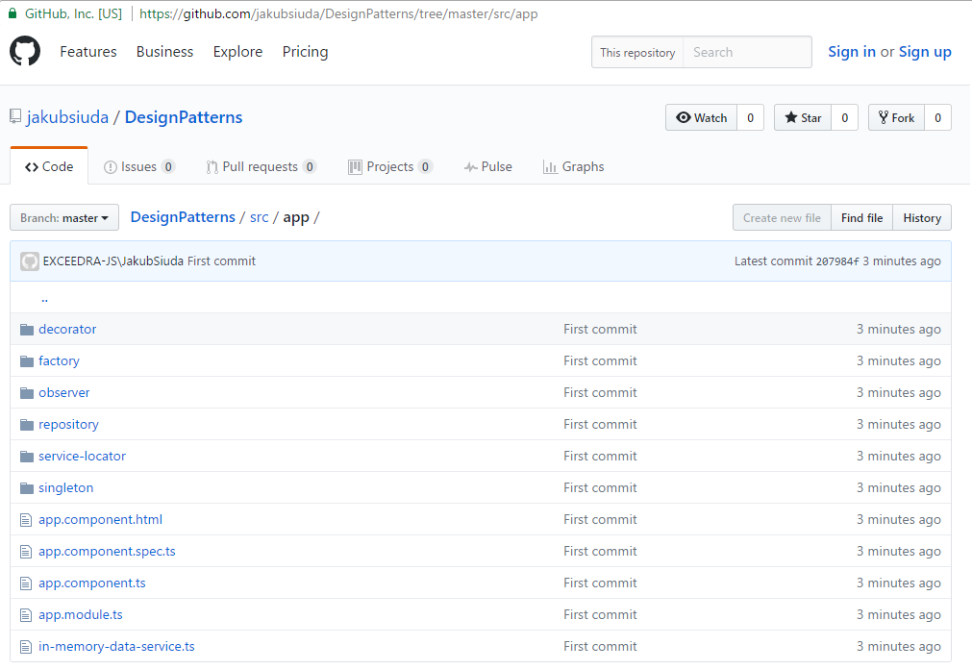
Demos – source code

